Slide 1


Introduction to Python
Fondren Library
Digital Scholarship Services

Slide 2


WHAT IS PYTHON?
Invented by a Dutch programmer Guido van Rossum as a “hobby” during Christmas week, 1989
Name comes from “Monty Python”
Open source
Companies: Instagram, Amazon, Facebook, SurveyMonkey…
Design philosophy: “Readability counts”

Slide 3
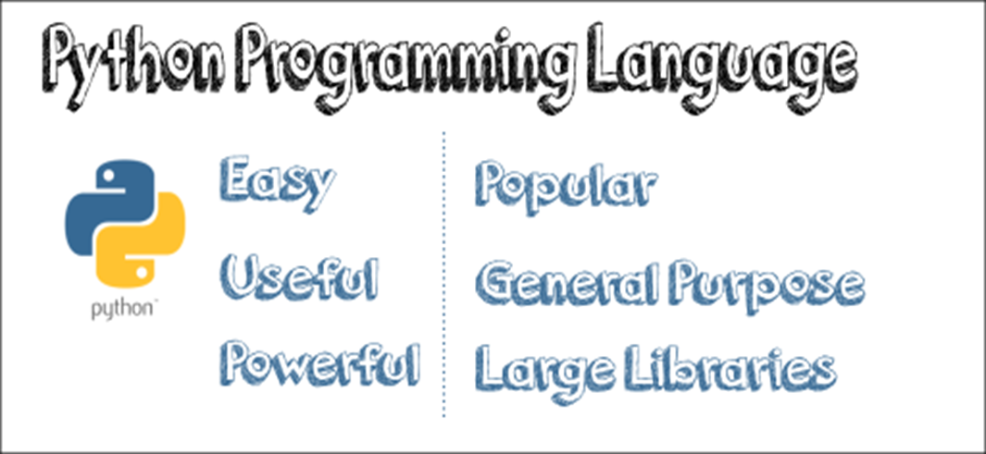
Why PYTHON?
#Python
print ("Hello world!" )
#Java
public class Main {
public static void main(String[ ] args) {
System.out.println( "Hello, World!’’ );
}
}

Slide 4
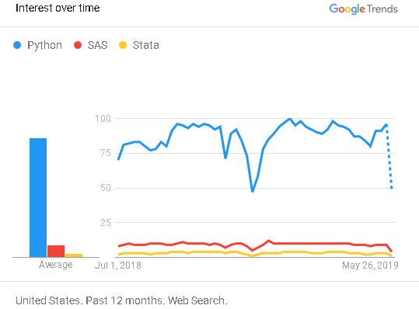
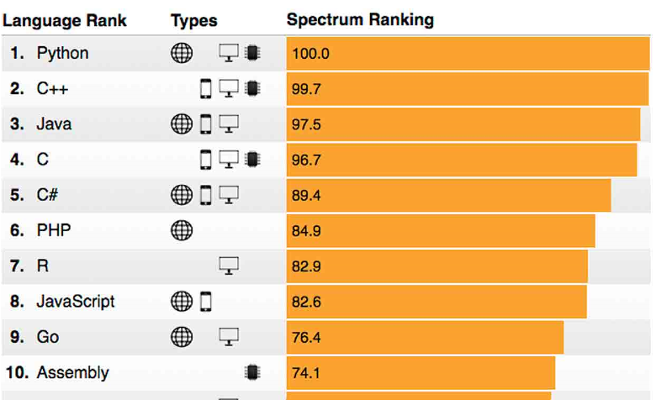
One of the most popular programing languages
Source: Google Trend
Top Ten Languages of 2018
Source: IEEE(Institute of Electrical and Electronics Engineers)
Spectrum’s fifth annual interactive ranking of the top programming languages

Slide 5
PYTHON IS USED FOR
Web Development
Data Analysis/visualization
Machine Learning
Web Scraping

Slide 6

Over 6 million users
Works on Linux, Windows, and Mac
1400+ packages pre-installed
IDEs including: Jupyter, JupyterLab, Spyder, and RStudio
Anaconda

Slide 7
DATA TYPES
Python knows various types of data. Common ones are:
Strings – “a”, “hi”
Integer numbers – 2, 4, 6,
Floating point numbers – 3.14, 2.0, 2.12
Boolean – True/False

Slide 8


CHECK AND CHANGE TYPES BUILT-IN FUNCTION type

Slide 9
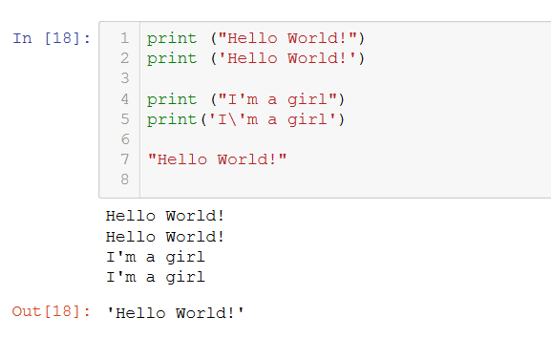
PRINT TEXT
"escape" character.

Slide 10
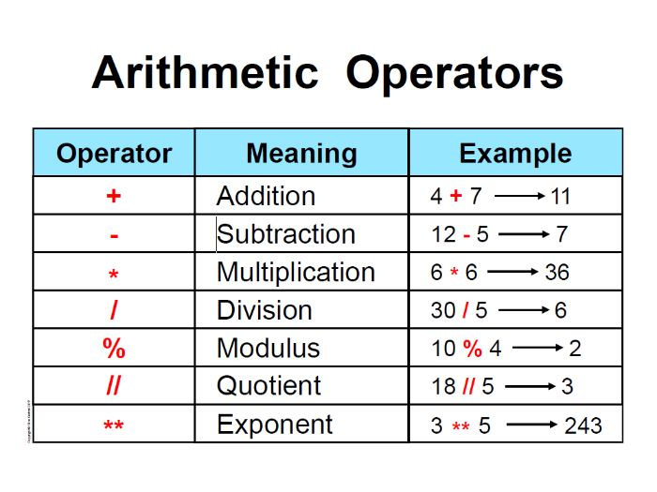

Slide 11
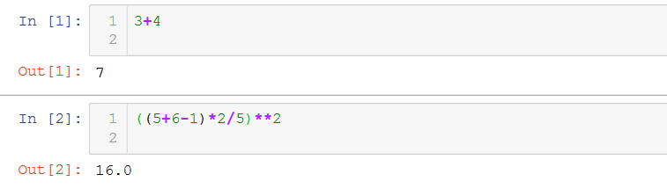
USE AS A CALCULATOR MATHEMATIC OPERATORS
+, -, /, *, %
# Exercise 1:
# Radius=5, π=3.14, calculate the area of the circle

Slide 12
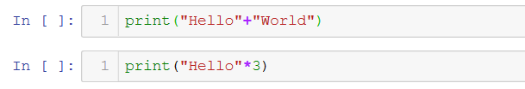
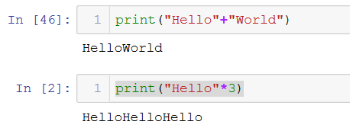
OPERATORS WORK DIFFERENTLY BASE ON DATA TYPE

Slide 13
LOGIC OPERATORS <, >, ==, !=, <=, >= AND STATEMENTS and, or, not RETURN BOOLEAN DATA TYPE

Slide 14


INPUT
#Exercise 2:
Create a variable affiliation, prompt a question, "Are you a student or a staff member?"
print "You are a " + input

Slide 15
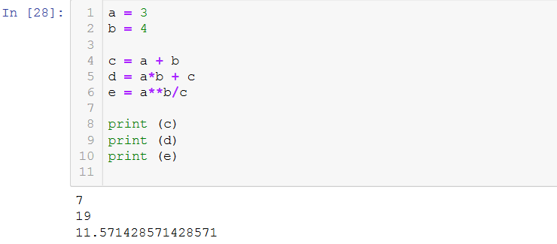
ASSIGNING VARIABLES

Slide 16
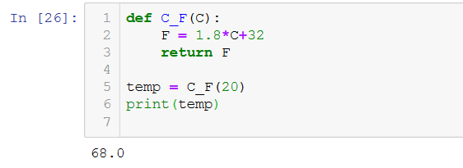
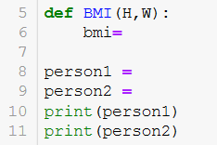
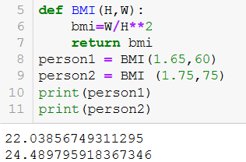
USER-DEFINED FUNCTION
Exercise 3: Create a BMI function and calculate BMI for person1 and person2. BMI = weight/height²
# person1: height:1.65m, weight:60kg
# person2: height:1.75m, weight:75kg

Slide 17
BASIC DATA STRUCTRUES IN PYTHON
Lists [1,2,3] ordered and changeable
Tuples (1,2,3) ordered and unchangeable
Dictionary {‘a’: 1, ‘b’:2, ‘c’:3} unordered, changeable and indexed

Slide 18

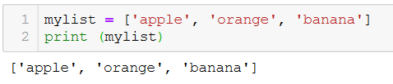
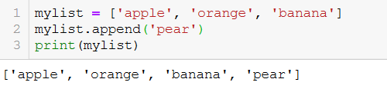

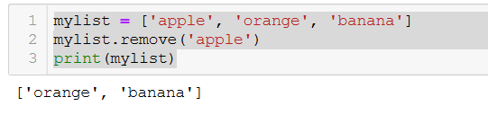
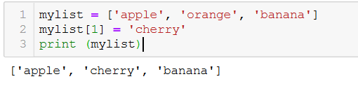
LIST
Create a list:
Access item:
Add Items:
Remove Items:
Change Item Value:
Exercise 4:
Create a list of your favorite songs, print the list
Print the 3rd item in the list
Change the 3rd item into another song
Add one more song
Remove one song

Slide 19
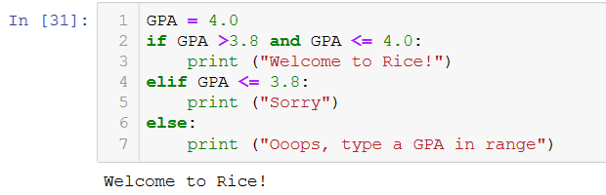
CONTROL FLOW – IF/ELSE
Exercise 5: Create a variable called "behavior", assign a value "good" to it
# if "good" print "candy"
# elif "bad" print "no candy"
# else print "ask your mom"

Slide 20
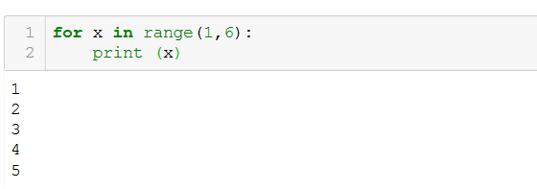
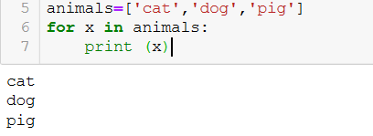
CONTROL FLOW – FOR LOOP
Exercise 6
Create a list called “animals" and put "cat","dog","pig"...in it
Use for loop to print each one out

Slide 21
Useful Libraries
Beautiful Soup – web scraping
NumPy – advance math functionalities
Matplotlib – graphs
Pandas – data structures and data analysis tools

